Slide 1



AAC BMS IN KSA

Slide 2
About Al Salem
Johnson Controls operates though Al Salem in KSA, Egypt, Lebanon and Yemen.
Established in 1991, Al Salem Group of Companies in Saudi Arabia joined arms with YORK’s mother company "Johnson Controls", a leading multi-industrial company and a pioneer provider of integrated solutions that incorporate HVAC equipment, fire and security systems, building management systems and controls, for the residential, commercial and industrial sectors, in the Kingdom of Saudi Arabia, Lebanon, Egypt & Yemen
With a workforce exceeding 2000 employees, Al Salem YORK is strategically located across the Kingdom of Saudi Arabia to serve its’ diverse customers and industries, though our head office, branches and a well-established solid network of dealers and distributors.

Slide 3
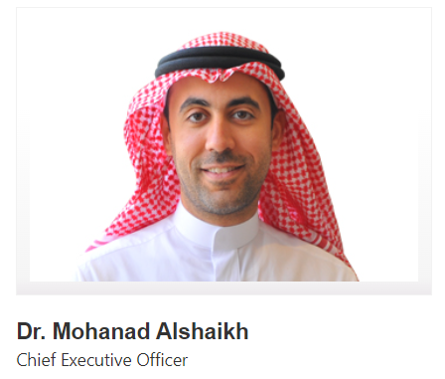
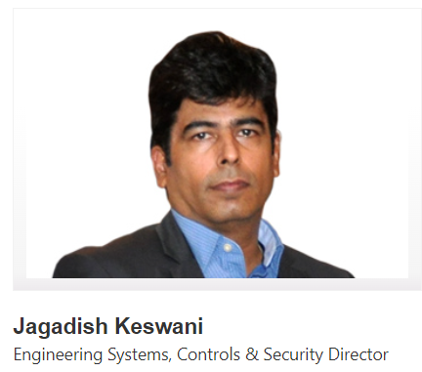
Management Team
Dr. Mohanad Alshaikh joined the company as the Director of Operations in 2010 and assumed the role of CEO in 2014, overseeing operations in Saudi Arabia, Lebanon, Egypt & Yemen. He holds a Bachelor’s Degree in International Finance, a Bachelor’s and a Master’s Degrees in Information Systems, and a Doctorate level degree in Engineering in Information Technology. He completed executive education programs in Science & Technology, Innovation and International Business. Prior to joining Al Salem Johnson Controls, Dr. Mohanad served at the Royal Embassy of Saudi Arabia in Washington DC where he liaised with US Congress. He also worked for the World Bank Group and currently serves as a board member in various companies and NGOs.
Jagadish has 27 years of experience in the Buildings Industry, with deep knowledge in Building Controls, Automation, HVAC, Life Safety and Security Products & Solutions. He worked with Leading Multi-Industry Global Organizations like Johnson Controls Inc. and Ingersoll Rand in the past 20 years and in a Senior Leadership role (VP/Director) past 9 years. He joined Al Salem Johnson Controls in 2014. As Director he oversees the Controls & Security Systems and Products Business for KSA. Jagadish holds a Bachelor in Engineering, Instrumentation and Controls.

Slide 4




JCI PRODUCTS IN KSA

Slide 5



JCI PRODUCTS IN KSA
Bahrain Distributor |  |  | None

Slide 6

JCI PRODUCTS IN KSA
Bahrain Distributor |  |  | None
KSA Distributor | Only available for JCI branch | 5 partners | 1 partner

Slide 7
JCI PRODUCTS IN KSA
Bahrain Distributor |  |  | None
KSA Distributor | Only available for JCI branch | 5 partners | 1 partner
Availability for AAC | Not available | Available | Available

Slide 8


JCI PRODUCTS IN KSA
Bahrain Distributor |  |  | None
KSA Distributor | Only available for JCI branch | 5 partners | 1 partner
Availability for AAC | Not available | Available | Available
COO | Mexico-North America | Mexico-North America | China

Slide 9

JCI PRODUCTS IN KSA
Bahrain Distributor |  |  | None
KSA Distributor | Only available for JCI branch | 5 partners | 1 partner
Availability for AAC | Not available | Available | Available
COO | Mexico-North America | Mexico-North America | China
Software | OWN Metasys ADS/ADX | 3rd Party Niagara Tridium | 3rd Party Niagara Tridium

Slide 10
JCI PRODUCTS IN KSA
Bahrain Distributor |  |  | None
KSA Distributor | Only available for JCI branch | 5 partners | 1 partner
Availability for AAC | Not available | Available | Available
COO | Mexico-North America | Mexico-North America | China
Software | OWN Metasys ADS/ADX | 3rd Party Niagara Tridium | 3rd Party Niagara Tridium
Supervisory controllers | OWN SNE & SNC series | 3rd Party Tridium | 3rd Party Tridium

Slide 11
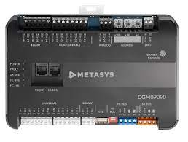
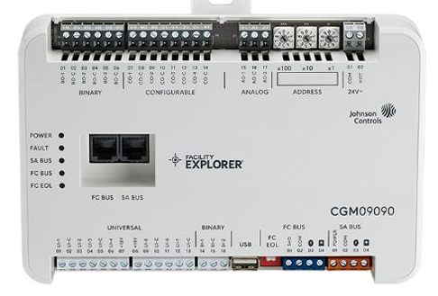
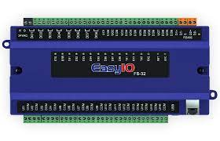
JCI PRODUCTS IN KSA
Bahrain Distributor |  |  | None
KSA Distributor | Only available for JCI branch | 5 partners | 1 partner
Availability for AAC | Not available | Available | Available
COO | Mexico-North America | Mexico-North America | China
Software | OWN Metasys ADS/ADX | 3rd Party Niagara Tridium | 3rd Party Niagara Tridium
Supervisory controllers | OWN SNE & SNC series | 3rd Party Tridium | 3rd Party Tridium
DDC Controller

Slide 12
Thank You
Building Management System

